Slide 1
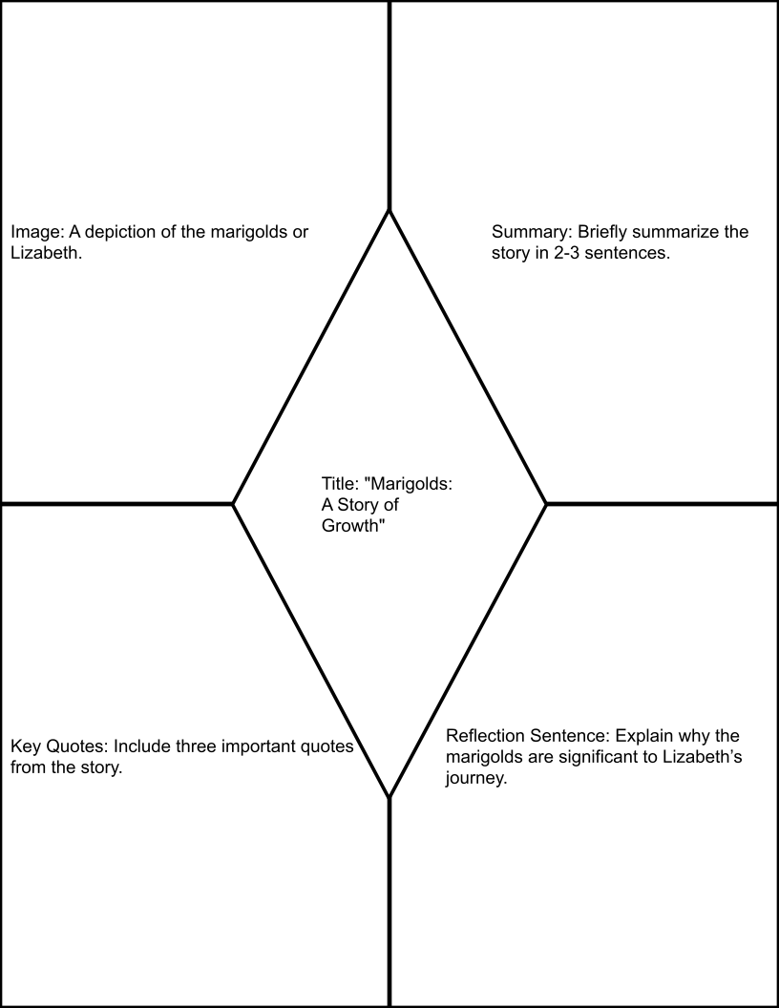
How to Add Color to the One-Pager
Each section of the one-pager begins transparent so you can see the guide words underneath. The guide words are only there to show you what belongs in each section.
Use the paint bucket / fill color tool to add color to every section of the one-pager. When you add color, it is okay if the guide words disappear or get covered. Your real directions are in the assignment document, not on the background image.
After you color each section, add your own text, images, and quotes on top of the colored areas.
Steps:
Click on a transparent section of the one-pager.
Click the paint bucket / fill color tool.
Choose a color for that section.
Repeat until every section has color.
Then add the required writing or image for each part of the one-pager.
Reminder: If you color the wrong part, click Undo and try again. Make sure every section is colored before you turn it in.
This document counts as the center tic-tac-toe board square. Remember to create/copy and attach the other two required documents.

